Slide 1
NEXTHIKES IT SOLUTIONS
SALES FORECASTING ACROSS MULTIPLE RETAIL STORES.
BY :- NAMAN SHARMA

Slide 2
AGENDA
PROJECT OVERVIEW.
DATA ANALYSIS.
EDA .
Sales before and after holidays.
Average Month Sale.
Correlation Between Customer And Sales.
Sales During Promo and Sales During Non-Promo.
Sales Per Day(Monday - Saturday).
ML Model.
Feature Importance.
Time Series.
Deep Learning.
app.py.

Slide 3
Project Overview
The main objective of the project was to forecast daily sales for their retail stores across multiple cities up to six weeks in advance. Traditionally, store managers were making sales predictions based on personal judgment and past experience, which often lacked accuracy.

Slide 4
Data Analysis
Datasets
Historical store sales
Promotions
Holidays
Assortment
Competition.
Key Field
•Sales (Target), Store ID, Date
•Promotions (Promo, Promo2, Promo Interval)
•Holidays (State Holiday, School Holiday)
•Competition Distance & Opening Info
•Store Type & Assortment

Slide 5
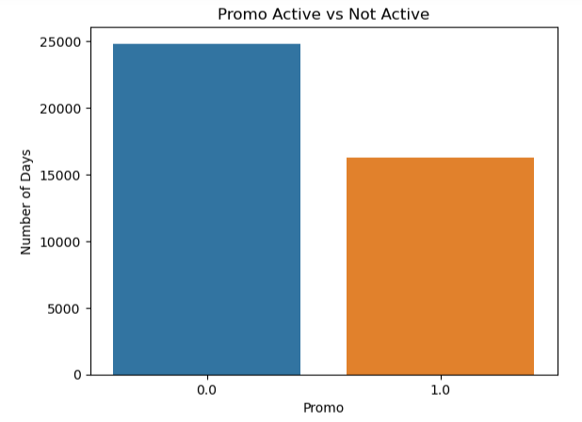
Promo Distribution
The given plot shows the distribution of days when promotions were active versus not active in the dataset. If the bars are uneven, it indicates more days without promotions or vice versa. This helps understand how often promotions are run, which can impact sales patterns and customer behavior.

Slide 6
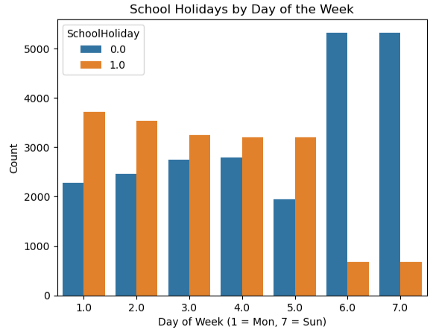
School Holiday Patterns by Day of Week
This plot reveals how school holidays are distributed across the days of the week. Typically, higher counts on certain weekdays with school holidays can indicate when stores might experience altered customer traffic due to holidays. It helps identify if weekends or specific weekdays have more school holidays, which can influence sales and staffing needs.

Slide 7
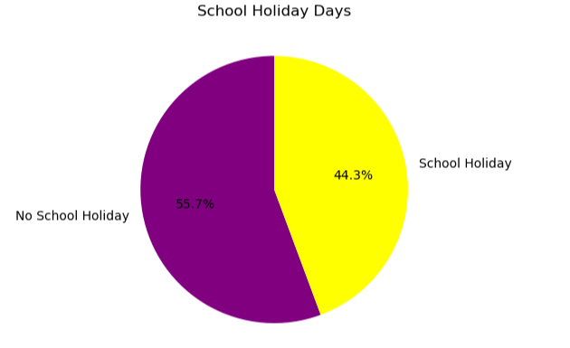
School Holiday
The pie chart reveals the proportion of days with and without school holidays. A larger "No School Holiday" slice suggests most days are regular school days, while the smaller "School Holiday" portion indicates fewer holiday days. This helps understand how school holidays might affect customer footfall and sales patterns.

Slide 8
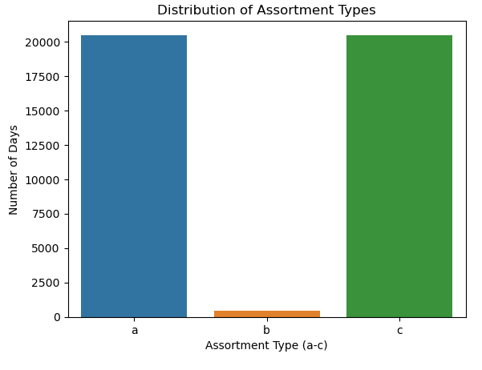
Assortment Type Distribution
This plot displays the distribution of assortment types 'a' to 'c' across the dataset. The dominant assortment type(s) reflect the most common product variety offered by stores on given days, which can affect customer preferences and sales. Less frequent types might indicate specialized or limited product selections.

Slide 9
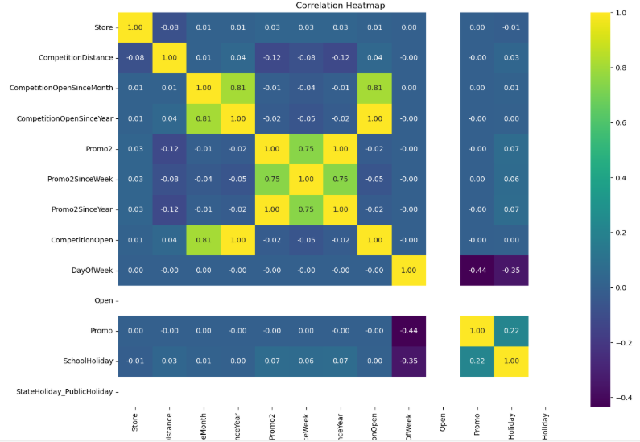
Correlation of Numeric Features.
This full correlation heatmap displays the strength and direction of relationships between all numeric features in the dataset. Bright colors indicate strong positive or negative correlations, helping to identify which variables move together and which may be redundant or impactful for modeling. It’s a great overview to spot key predictors and multicollinearity issues.

Slide 10
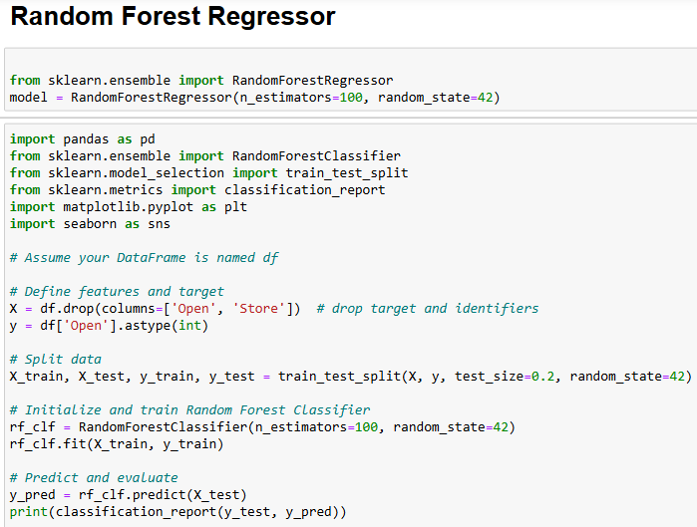
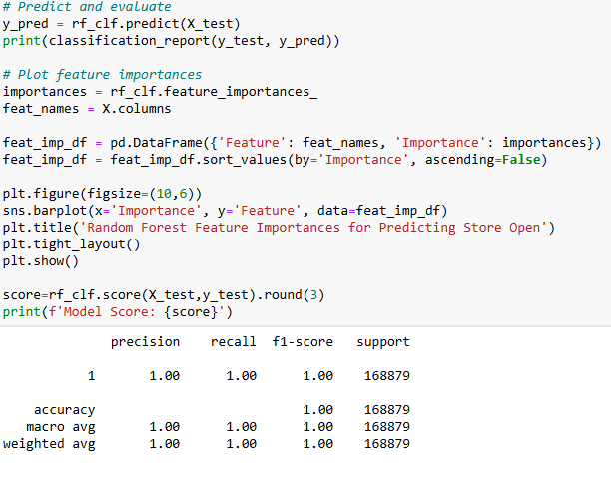
ML Model

Slide 11
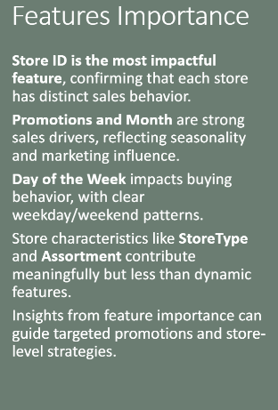
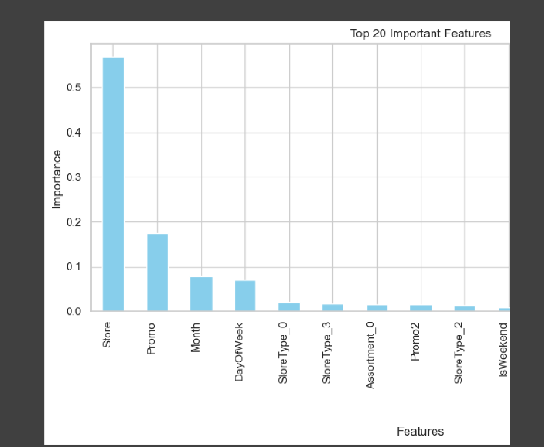
Feature Importance

Slide 12
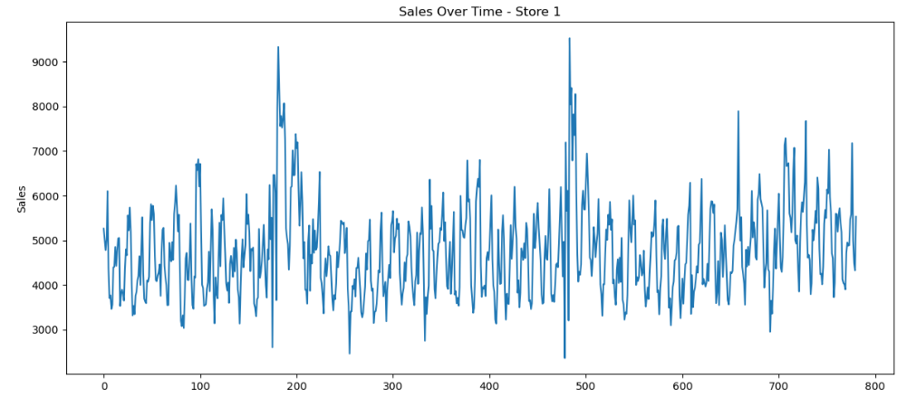
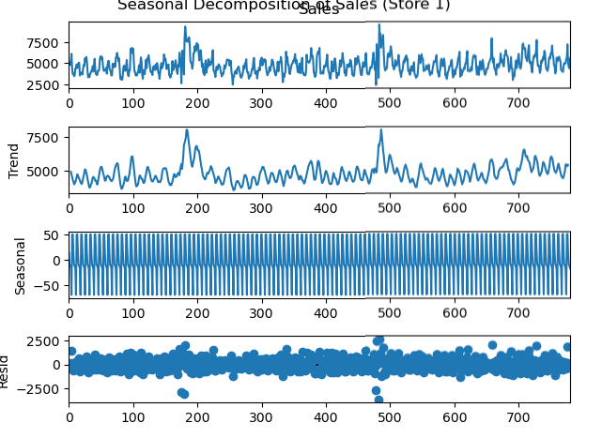
Time Series Analysis

Slide 13
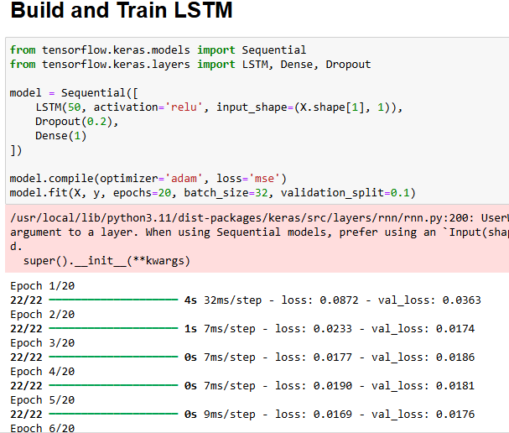
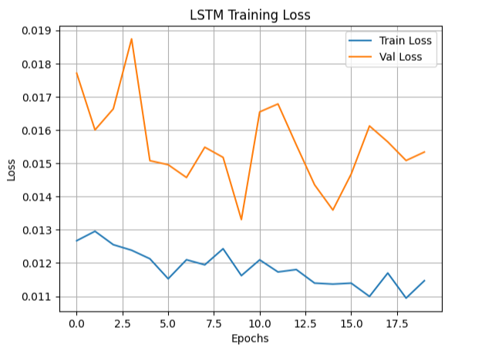

Slide 14
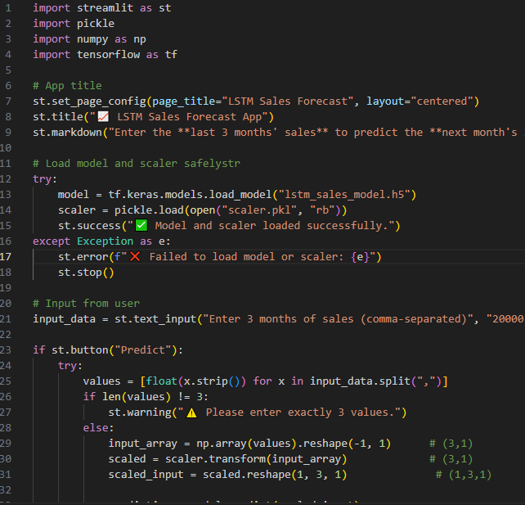
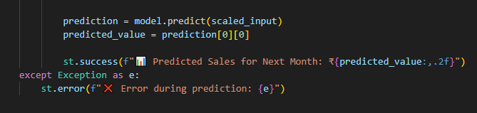
app.py

Slide 15
THANK YOU

